Slide 1

CISM 190: Intro to Tech
April 2017
Week 4

Slide 2
Agenda for today
VR discussion
Quiz time
Lecture: file systems, HTML, JavaScript
Exercise: build a file system
Exercise: build your first webpage!
Lab time

Slide 3
Lecture Rules
There are no stupid questions
Learning is the objective
Everyone learns together
Help each other
Notes:
http://w3schools.pro.edu/jsref/jsref_obj_string.html

Slide 4
Discussion: Virtual Reality

Slide 5


Slide 6
Virtual/Augmented/Mixed Reality (VR/AR/MR)
What is virtual, augmented, mixed reality? What are the differences between the three?
What are current consumer applications of VR/AR/MR?
What commercial applications of VR/AR/MR might we see in the next 3 years?
What are the benefits and risks of using VR/AR/MR in prison?
How could those other benefits and risks be applied to other groups? (e.g. teachers, police, social workers)

Slide 7
Moodle log in

Slide 8
To log into Moodle:
Open Chrome. It should automatically redirect you to moodle.un-loop.org (then turn into an IP address)
Your username is your last name and first initial
Example: burgundyr
Your password is a tilde (~), the first 4 letters of your last name with the first letter in CAPS, and the last 3 numbers of your DOC number
Example: ~Bur1234
You should see “Unloop Intro to Tech” on your dashboard

Slide 9
Quiz time!

Slide 10
Today’s Class
File Systems & files
Browsers
HTML
JavaScript

Slide 11
File Systems
I know, very exciting
For the purpose of understanding:
File System = Computerized Filing Cabinet
What is it really:
A file system is a collection of files, folders, directories and associated pointer data, security data and other information necessary to manage the files.

Slide 12
File Systems, continued!
What are common file systems?
NTFS (NEW TECHNOLOGY FILE SYSTEM) WINDOWS NT, XP, VISTA, WINDOWS 7, WINDOWS 10)
FAT16 (FILE ALLOCATION TABLE 16 BIT)
FAT32 (FILE ALLOCATION TABLE 32 BIT)
ISO 9660 (INTERNATIONAL STANDARDS ORGANIZATION) AKA CDFS
File systems reside on:
Disk Drives
Flash Drives
CD ROMS/DVDs
Network Drives
Notes:
- This is an example of something you will NEVER have to know these names. But for reference:
NTFS – New Technology File System – this is how your C drive is set-up
Describe difference between volatile (networked) and non-volatile (local) devices to put your file systems

Slide 13
WHAT IS A FOLDER?
A folder is a container in a file system that contains files and folders. Folders are used to organize the information that is stored on the storage device. Folders are also called directories.
WHAT IS A FILE?
A file is a collection of sequential bytes of data. A file may contain: • PROGRAM(S) • DATA • MUSIC • PICTURES • MOVIES, etc
Application programs are executable code that perform useful work for the user. Examples are – Windows Explorer, Internet Explorer, Wordpad, Turbo Tax, etc.
Data files contain information that is useful and of value to the user of the personal computer e.g. text documents, pictures, financial data, (stock, income tax data, bank account, etc.)

Slide 14
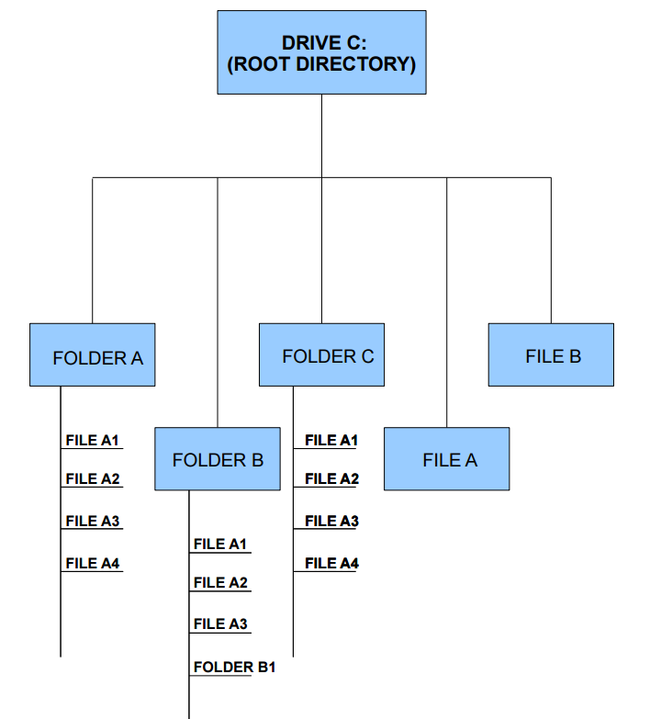
File systems are like trees!
Root = drive/directory
Branches = folders
Files = leaves

Slide 15
Using File Explorer
Panes
Navigation Pane
Content Pane
Preview Pane
Ribbon
PLUS:
Search
With File Explorer we can copy, delete and move files. Simply right click on the file name and select the Cut, Copy, Delete, or Rename options.

Slide 16
Naming Files and Folders
Consistent, Descriptive
Options:
Project Name
Location
User name
Date/time (YYYYMMDD, DDMMYY)
Version Numbers (v1, v2)
Try not to make file names too long, since long file names do not work well with all types of software.
Special characters such as ~ ! @ # $ % ^ & * ( ) ` ; < > ? , [ ] { } ' " and | should be avoided.
You can use:
Underscore: david_Almeida
Dashes:
CapitalizationLikeThis (called camel case)
Notes:
How you organize and name your files will have a big impact on your ability to find those files later and to understand what they contain. You should be consistent and descriptive in naming and organizing files so that it is obvious where to find specific data and what the files contain.
It's a good idea to set up a clear directory structure that includes information like the project title, a date, and some type of unique identifier. Individual directories may be set up by date, researcher, experimental run, or whatever makes sense for you and your research.
Do not use spaces. Some software will not recognize file names with spaces, and file names with spaces must be enclosed in quotes when using the command line. Other options include:
Underscores, e.g. file_name.xxx
Dashes, e.g. file-name.xxx
No separation, e.g. filename.xxx
Camel case, where the first letter of each section of text is capitalized, e.g. FileName.xxx

Slide 17
File Types
You can’t remember them all…
Here’s a sample list
.doc
.csv
.xls
.html
.js
.pdf
.jpeg
+10000000 more

Slide 18
File Paths
For understanding:
File Path is the directions to your file
Example:
C:\Users\david\Downloads\Unloop
What would happen if we tried to name a file: david/almeida.html?

Slide 19
Exercise: Build a file system
In your student drive, set-up a series of folders to organize your work in Web Development (you will need to create folders!)
Example:
In Class Assignments
Homework
Materials
Archive
Rename files using naming best practices
Shortcut keys:
Ctrl +x = cut
Ctrl +c = copy
Ctrl + p = paste
Grading - you will be graded on:
Are the files in your folder logically organized?
Are files and folders named using best practices?

Slide 20
Web Development Files
HTML (Hypertext markup language)
CSS ( Cascading Style Sheets)
JavaScript
How do you make an HTML file?
What about a CSS file?
What about a JavaScript file?
Notes:
HTML: Hyper Text Markup Language - The code structure used to convey the content of a web site
CSS: Cascading Style Sheets - A language used to describe the presentation of the content
WYSIWYG: What You See Is What You Get - A type of editing software meant to be used by those who don't know how to code
You may use JavaScript to make things interactive

Slide 21
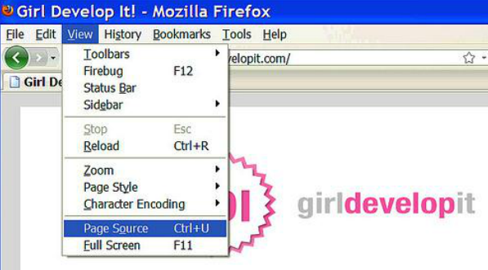
Browsers
Browsers are programs that render content on the web, most often HTML pages
When you are looking at a browser rendering content (like a webpage), you can click “view source” to look at the HTML file

Slide 22
HTML
Hypertext Markup Language
The content of your page!
It’s a text file, containing markup tags
Those tags tell the browser what to display

Slide 23
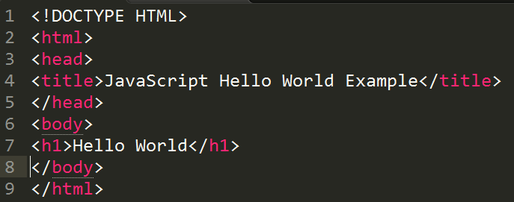
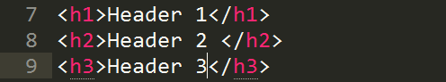
HTML
Each tag has a
Start tag <body>
End tag </body>
Some content in between
Optional attributes
Think of a tag as a “command” to the browser
Head and Body
<head> is a description of the page purpose/content. Nothing is rendered
<body> tag contains the actual content of a page

Slide 24
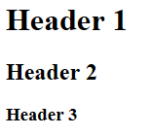
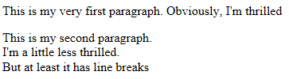
What goes in the “body”
Headers: <h1> </h1>, <h2> </h2>, etc.
Paragraphs: <p> </p>
Line Breaks: <br> </br>

Slide 25
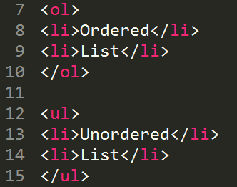
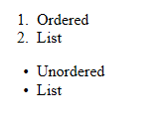
What goes in the “body”, lists!
Lists: <li> </li>
Unordered Lists <ul> </ul>
Ordered Lists: <ol> </ol>

Slide 26
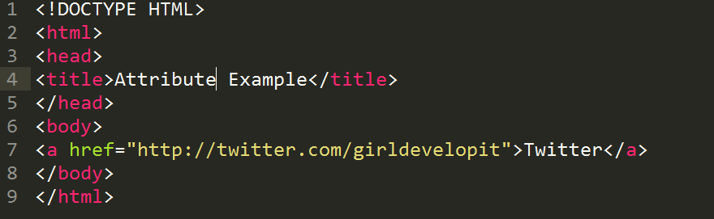
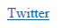
Attributes
A great way to embed links
<a> </a>

Slide 27
Exercise 1: Create an HTML File
Create & save a HTML document as “index.html” in your “websiteLab” folder
Add your metadata using the <html></html> tag
Add a title that says “Your name’s website” (in the <title></title> tags)
Add a header that says “Hello World” (use <h1></h1> tags)
Add a paragraph detailing why you love breakfast as a meal (use <p></p> tags)
Bonus
Add a list of your favorite breakfast foods (mess with ordered/unordered)
Try to minimize the number of times you use the mouse! Can you write a <p></p> tag without it?
Note: When you are writing code, it can be time consuming to go back and forth Use the printed out “Hotkeys” as much as possible.

Slide 28
Comments
Comments are lines that will be ignored by your code.
Options
/* Comment here */
Useful to document how code works or why it is there – makes your code “readable”
COMMENT ALL THE TIME!
Exercise: Add a comment to your HTML file

Slide 29
At this stage you should have…
An HTML file named “index.html” in your “websiteLab” folder in your share
The title of the page should be “yourname’s website”
There should be a header that says “Hello world”
There should be a paragraph that says a little something about breakfast
There should be a comment in your file
And maybe some lists and stuff

Slide 30
JavaScript, what does it do?
Makes your code interactive
Drawing, animation
Keeps tracks of users with cookies!
JavaScript can change HTML content
JavaScript can change HTML attributes
JavaScript can change CSS style
JavaScript can hide HTML elements
JavaScript can show hidden HTML elements

Slide 31
JavaScript, Output
Writing into an window alert box
<script>
window.alert(5 + 6);
</script>
Writing into the HTML output
<script>
document.write(5 + 6);
</script>
Writing into an HTML element
<p id="demo"></p>
<script>
document.getElementById("demo").innerHTML = 5 + 6;
</script>
Writing into the browser console
Console.log(5+6)

Slide 32
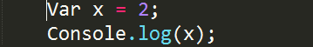
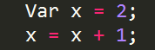
JavaScript, Statements
Each instruction in JS is a “statement”, like:
Console.log(‘Hello World!’);
Variable
Used to store values
Values can be updated

Slide 33
JavaScript, Write your first program!
<!DOCTYPE html>
<html>
<body>
<h1>My First Web Page</h1>
<script>
window.alert(5 + 6);
</script>
</body>
</html>

Slide 34
Exercise 3: Write a JavaScript program
Write a program that has an output of your own name using JavaScript
Bonus:
Use a different output method than your first try
Use a variable
Use a function
Notes:
Project manager – lindsey
Dev, devops, dev in test - mikey
Ui, UX, - mikey

Slide 35
At this stage you should have…
Required: (3 points each)
An HTML file named “index.html” in your “websiteLab” folder in your share
The title of the page should be “yourname’s website”
There should be a header that says “Hello world”
There should be a paragraph that says a little something about breakfast
There should be a comment in your file
An output of your own name on the page (window alert or html output)
Optional: (.5 point each)
An ordered list
An unordered list
An output using a different method than you used before that says “Robots”

Slide 36
JavaScript Data Types
String: an immutable string of characters
Var greeting = “hello there”;
Number: whole or decimal number
Var pi = 3.14;
Boolean: Represents a logical value of true or falce
Var dogsrule = true
Undefined: represents a value that hasn’t been defined yet
Var notDefinedYet;
Null: Represents an explicitly empty value
Var goodPickupLines = null;

Slide 37
JavaScript, Expressions
Variables can also store the result of any expression
Var x = 2+2
Var y = x * 3
Var name = ‘Lindsey’;
Var greeting = ‘Hello’ + name;

Slide 38
JavaScript, Comments
Again, comments are human-readable text ignored by computer
Used for documentation
Ways to comment
// comment here
var x= 4 // comment after a line
/* or like you did in css */
COMMENT ALL THE TIME!

Slide 39
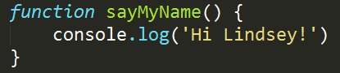

JavaScript, Functions
Functions are re-usable collections of statements
First, declare the function
Then call on it
Notes:
https://s3.amazonaws.com/TrainingNerd/JavaScriptForBeginners/Variables%20and%20Functions/player.html

Slide 40
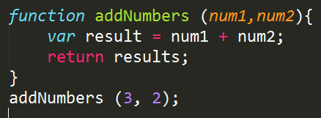
JavaScript, Arguments/Parameters
Functions can accepts any number of named parameters arguments
Parameters are the names listed in the function definition, EXAMPLE: num1
Arguments are the real values passed to and received by the function, EXAMPLE: 3
Notes:
https://s3.amazonaws.com/TrainingNerd/JavaScriptForBeginners/Variables%20and%20Functions/player.html

Slide 41
For the rest of class today:
Finish up the Blockly lab if you haven’t already
Finish today’s exercise: first website
Spend some time on your Unloop application
If you finish all this stuff and want to push forward
Experiment with what we learned about HTML & JavaScript
Come see me for the Week 5 lab

